Slide 1
Big Data Week 11 Machine Learning with Spark
Professor Arturo Castellanos, PhD
Assistant Professor – William & Mary
Big Data - MSBA

Slide 2
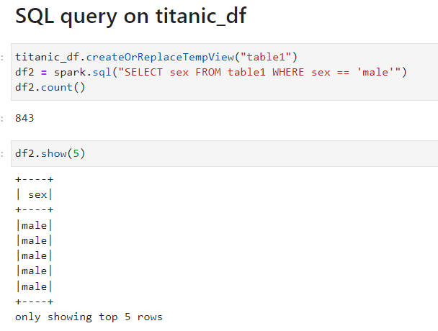

Executing SQL Queries
Check out the Google Colab notebook!
The SparkSession provides a method called sql which can be used to execute a SQL query.
The sql method takes a SQL statement as an argument and returns a DataFrame representing the result of the given query.
Unfortunately, SQL queries cannot be run directly against a DataFrame. To issue SQL queries against an existing DataFrame we can leverage the createOrReplaceTempView function to build a temporary table
After creating the temporary table, we can simply use the sql method, which allows us to write SQL code to manipulate data within a DataFrame.

Slide 3
Executing SQL Queries
The SparkSession provides a method called sql which can be used to execute a SQL query.
The sql method takes a SQL statement as an argument and returns a DataFrame representing the result of the given query.
Unfortunately, SQL queries cannot be run directly against a DataFrame. To issue SQL queries against an existing DataFrame we can leverage the createOrReplaceTempView function to build a temporary table
After creating the temporary table, we can simply use the sql method, which allows us to write SQL code to manipulate data within a DataFrame.

Slide 4
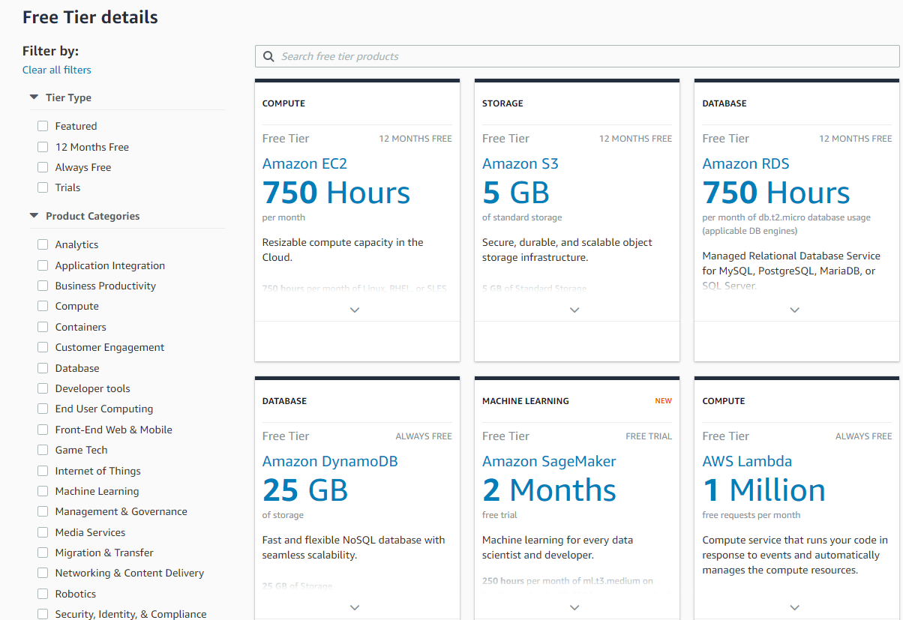

Slide 5
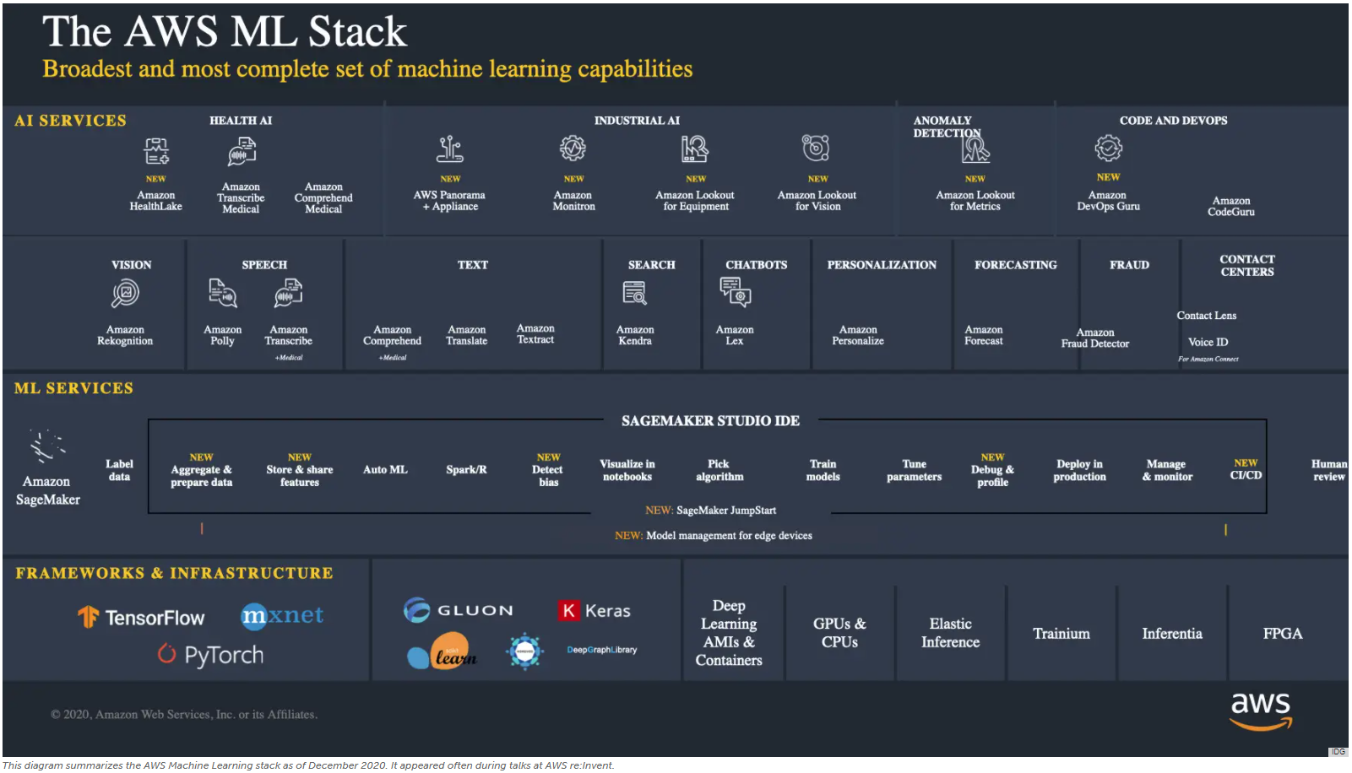

Slide 6
Today’s Class
Machine learning with Spark
Group project?
Is there anything I can help with?
Something you would like me to cover.

Slide 7
Data Mining Frameworks
1. Crisp-dm
• As a methodology, it includes descriptions of the typical phases of a project, the tasks involved with each phase, and an explanation of the relationships between these tasks.
• As a process model, CRISP-DM provides an overview of the data mining life cycle.
Source: https://www.ibm.com/support/knowledgecenter/SS3RA7_15.0.0/com.ibm.spss.crispdm.help/crisp_overview.htm

Slide 8
Machine Learning: Supervised vs. Unsupervised Learning
Supervised Learning (Estimation and Classification)
The training data contains target class information for each record (e.g. spam, churn).
New records are classified based on the models developed on the training data (e.g. scoring).
Classification predicts whether something will happen, whereas regression predicts how much something will happen
Unsupervised Learning (Clustering)
The classification of the training data is unknown.
The aim is to construct a set of clusters, given the data.

Slide 9
Supervised: Classification
Goal: Predict categorical target (outcome) variable
Examples: Purchase/no purchase, fraud/no fraud, creditworthy/not creditworthy…
Each row is a case (customer, tax return, applicant)
Each column is a variable
Target variable is often binary (yes/no)

Slide 10
General Approach for Building Classification Model

Slide 11
Supervised: Prediction
Goal: Predict numerical target (outcome) variable
Examples: sales, revenue, performance
As in classification:
Each row is a case (customer, tax return, applicant)
Each column is a variable
Taken together, classification and prediction constitute “predictive analytics”

Slide 12
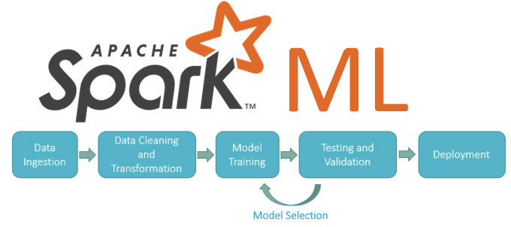
Jupyter Notebook

